Slide 1

P peline
The Data
Iterative Design
© Jennifer Mankoff & Nikola Banovic
The Data Pipeline; HCII; Spring 2017

Slide 2
Marshmallow Challenge
http://www.tomwujec.com/design-projects/marshmallow-challenge/

Slide 3
Goals for today
Quiz
Iterative Design
Discuss Project 1

Slide 4
Goals for today
Quiz:
Itsmarch
Q3: WHICH OF THE FOLLOWING IS AN EXAMPLE OF THE DISTORTION TECHNIQUE

Slide 5
Learning Goals
Define iterative design
Tell a difference between a waterfall model and iterative design approach
Apply iterative design approach to your data pipeline

Slide 6
Waterfall Model
REQUIREMENTS
DESIGN
IMPLEMENTATION
TESTING
MAINTENANCE
Notes:
What can go wrong?
What can we do better?

Slide 7
Waterfall Model
REQUIREMENTS
DESIGN
IMPLEMENTATION
OH NO!
TESTING
MAINTENANCE
Notes:
More often than not you can have the “Oh no!” moment once you have done all that work.

Slide 8
Iterative Design
“Iterative design is a design methodology based on a cyclical process of idea generation, evaluation, and design improvement.” [Park and Wong, 2010. A Case Study of a Systematic Iterative Design Methodology and its Application in Engineering Education]

Slide 9
Where do we iterate?
REQUIREMENTS
DESIGN
IMPLEMENTATION
TESTING
MAINTENANCE

Slide 10
Where do we iterate?
Contextual Design
(Beyer & Holtzblatt)
REQUIREMENTS
DESIGN
EVALUATE
PROTOTYPE
Discount Usability
(Neilsen)
Notes:
Different processes to help you iterate on your design. Contextual Design not the focus here, but Discount Usability can help you at least catch some early errors.

Slide 11
Where do we iterate?
REQUIREMENTS
DESIGN
EVALUATE
PROTOTYPE
IMPLEMENTATION
TESTING
MAINTENANCE
Notes:
Where else?

Slide 12
Where do we iterate?
REQUIREMENTS
DESIGN
EVALUATE
PROTOTYPE
IMPLEMENTATION
TESTING
USING
Notes:
Where else?

Slide 13
Data Pipeline
Question
Is it the right question?
Collect Data
Is it the right data for the question?
How hard/easy is it to collect?
Clean Data
What flaws exist in the data?
How do we address them?
Is it answerable?
Explore Data
Stats/Graphs/ML
Use data
Communicate/Predict/…
Intuition
Report on Findings
Visualize
Visualize
Notes:
Where in the pipeline can we iterate?

Slide 14
Data Pipeline
Question
Is it the right question?
Collect Data
Is it the right data for the question?
How hard/easy is it to collect?
Clean Data
What flaws exist in the data?
How do we address them?
Is it answerable?
Explore Data
Intuition
Use data
Communicate/Predict/…
Stats/Graphs/ML
Report on Findings
Visualize
Visualize
Notes:
Your midterm project asks you to iterate on your final visualization.

Slide 15
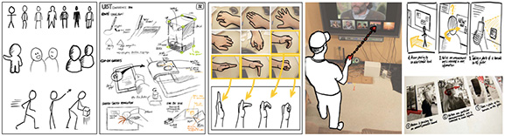
Prototyping Techniques
Sketches
Sketching User Experiences: The Workbook by By Saul Greenberg, Sheelagh Carpendale, Nicolai Marquardt, Bill Buxton

Slide 16
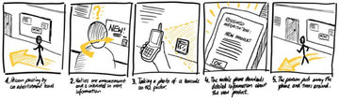
Prototyping Techniques
Scenarios
Sketching User Experiences: The Workbook by By Saul Greenberg, Sheelagh Carpendale, Nicolai Marquardt, Bill Buxton

Slide 17
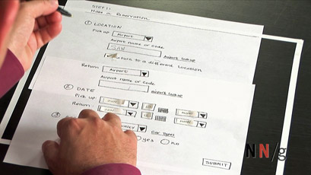
Prototyping Techniques
Paper Prototyping
Paper Prototyping
Nielsen Group

Slide 18
Prototyping Techniques
Paper Prototyping
https://www.youtube.com/watch?v=B7M0fVXdovM

Slide 19
Prototyping Techniques
Wizard of Oz

Slide 20
Prototyping Techniques
Wizard of Oz
https://www.youtube.com/watch?v=QX9cjsYBihc

Slide 21
Prototyping Techniques
Sketches
Scenarios
Paper Prototyping
Wizard of Oz
Notes:
Where and how could you use these in your pipeline?

Slide 22
Prototyping
Functionality
Fidelity

Slide 23
Prototyping
Functionality
Fidelity

Slide 24
IDEO Shopping Cart (ABC Nightline)
https://www.youtube.com/watch?v=M66ZU2PCIcM

Slide 25
Discount Usability Techniques
Simplified User Testing (Nielsen)

Slide 26
Discount Usability Techniques
Cognitive Walkthrough (Tog)

Slide 27
Discount Usability Techniques
Heuristic Evaluation (Neilsen)
10 Heuristics:
Visibility of system status
Match between system and the real world
User control and freedom
Consistency and standards
Error prevention
Recognition rather than recall
Flexibility and efficiency of use
Aesthetic and minimalist design
Help users recognize, diagnose, and recover from errors
Help and documentation

Slide 28
Discount Usability Techniques
Simplified User Testing
Cognitive Walkthrough
Heuristic Evaluation

Slide 29
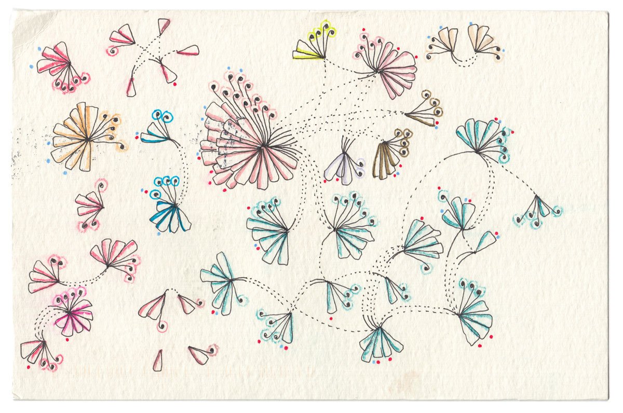
User Testing Visualization
Dear Data

